Slide 1

Code Quality
Vikrant Singh University of Paderborn PG- Data Portals 6864044

Slide 2
“We like to think we spend our time power typing, but we actually spend most of our time staring into the abyss.” - Douglas Crockford principal discoverer of JSON

Slide 3

Table of Contents
a) Naming Conventions
b) Indentation
c) Comments
d) Declarations
e) Statements
f) White Spaces
2) Test Quality on Github
3) IDE’s Code Formatting
g) Miscellaneous Practices
1) Coding Conventions
4) Suggestions and Questions
5) Task

Slide 4
Coding Conventions ”write code that minimizes the time it would take someone to understand it.”
Notes:
80% of the lifetime cost of a piece of software goes to maintenance. Hardly any software is maintained for its whole life by the original author.

Slide 5
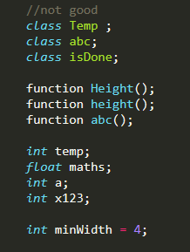

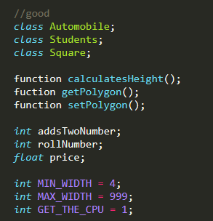
Naming Conventions
Name should convey the meaning as what does this class, method or variable do.
Class Name – Noun and UpperCamelCase.
Method Name – Verb and lowerCamelCase.
Variable Name – short and meaningful and lowerCamelCase.
Constants – Uppercased with words separated with underscores.
Notes:
Boolean name should be like isDone , isStarted , IsOn .

Slide 6
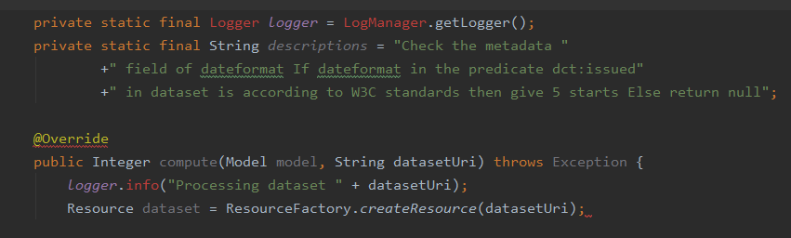
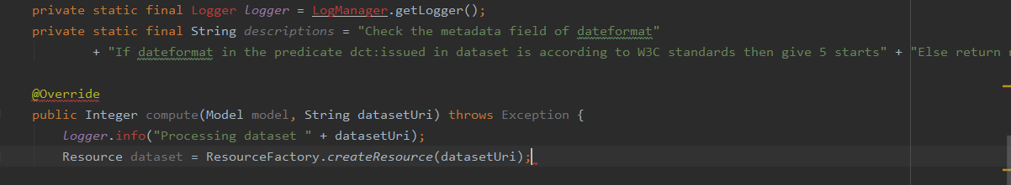
Indentation
Four spaces should be used as the unit of indentation.
Line Length : 60-80 Char per line.

Slide 7
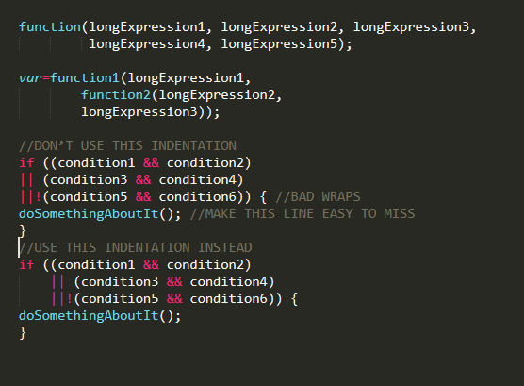
Wrapping Lines –
Break after a comma , before an operator.

Slide 8
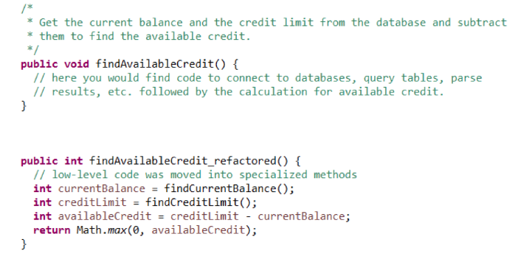
Comments in Code
“The proper use of comments is to compensate for our failure to express our self in code.” — Robert C. Martin, “Clean Code: A Handbook of Agile Software Craftsmanship”
Code should speak for itself.
Comment only when necessary.

Slide 9
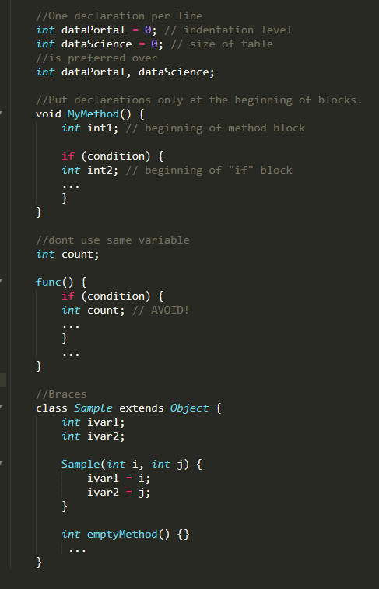
Declarations
One declaration per line .
Initialize local variable when declared.
Put declarations only at the beginning of blocks.
Open brace “{” appears at the end of the same line as the declaration statement.
Closing brace “}” should match its corresponding opening statement.

Slide 10
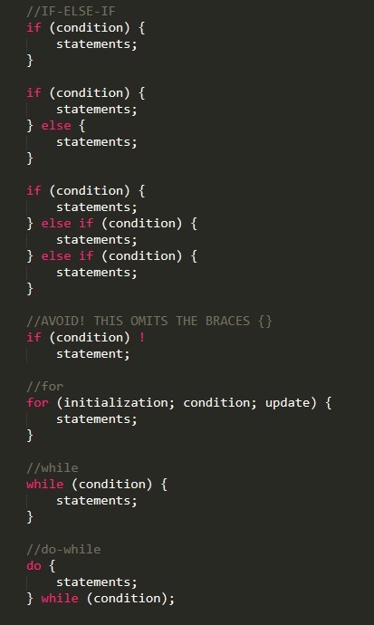
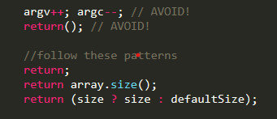
Statements
One statement per line.
Return statement without any value should be without parentheses.
If-else , for , while , do-while Statements should have the form:

Slide 11
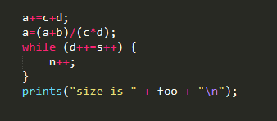
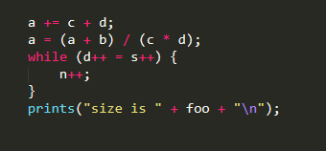
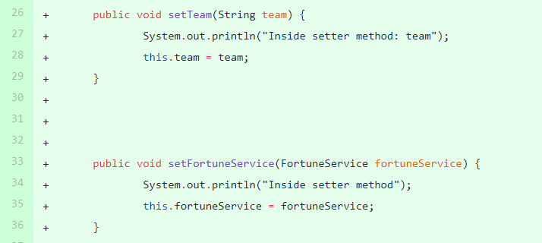
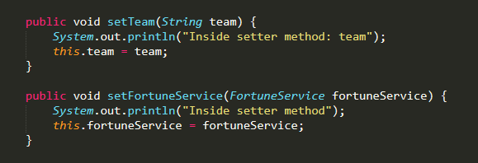
White Spaces
Blank lines improve readability by setting off sections of code that are logically related.
Put blank lines between methods , local variable and first statement and before comments.
A keyword followed by a parenthesis should be separated by a space.
Blank spaces should come between all binary operators(+,/,*,-,=) but not for ++,-- .

Slide 12

Miscellaneous Practices
Delete Unused Variables.
@Override: always use.
Parentheses
Write Generic and Re-useable Code . If a particular code is getting used too often ,wrap that in a method.
Less lines ,More Classes.
Use Enums wherever possible.
Write Unit Tests.
Hard-Code as less as possible.(Esp for UI-Design Implementation)

Slide 13
Code Quality on Github-
Code Reviews by Peers/Supervisors.
Automated Tools.

Slide 14
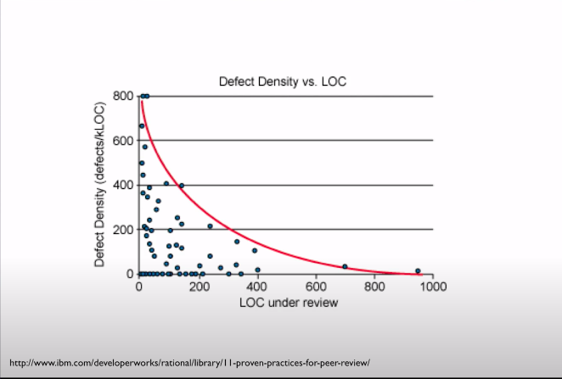
Code Reviews
Optimal Size of Pull Request – 400 LOC
Fewer issues are found in larger pull requests .

Slide 15

Automated tools
Tortoise Git.(for windows)
Codacy - https://github.com/marketplace/codacy
Github Marketplace - https://github.com/marketplace/category/code-review

Slide 16
IDEs
IntelliJ IDEA
Eclipse
Others

Slide 17
IntelliJ IDEA
Code Inspection - highlight various problems, locate dead code, find probable bugs, spelling problems, and improve the overall code structure. (Ctrl+Alt+S)
Code Formatting – arranges code according to the requirements you've specified in the Code Style settings.(Ctrl+Alt+L)
For more - https://www.jetbrains.com/help/idea/reformat-and-rearrange-code.html
Notes:
detect and correct anomalous code in your project before you compile it.

Slide 18
Eclipse
Code Inspection – Ctrl+Shift+I
Code formatting - Ctrl+I.
Other plugins - eclipse-pmd , Impact Tracer for Analyse JET

Slide 19
Suggestion or Questions ?

Slide 20
Task:
Even if it’s a temporary code , write that neatly. Use this presentation for better coding habits.
Notes:
I just want to say .

Slide 21

Thank You

